Slide 1
IBM University Engagement Project Submission
“Exploring the Power of Agentic AI with IBM Granite and LangFlow”

Slide 2

Project Title – PaperPilot AI
Intelligent Research Companion using IBM watsonx Orchestrate & IBM Granite
Domain of Project –Education / Research
Student Name | Recent Passport Photo | Email ID | Mobile number [WhatsApp]
Harshad Bhagat |  | harshadbgt@gmail.com | 8767791209

Slide 3
Problem Statement:
Problem Statement : Research Agent
The Challenge
Researchers, students, and professionals often spend significant time searching across journals, conference papers, technical reports, and online repositories. Research information is fragmented across multiple platforms, making literature review, paper summarization, citation management, and research trend analysis difficult and time-consuming. Existing search tools provide documents but rarely generate structured insights or identify research gaps.
Objective
Develop an Agentic AI-powered Research Agent capable of:
• Retrieving relevant research papers using Retrieval-Augmented Generation (RAG)
• Summarizing research articles
• Generating literature reviews
• Identifying research gaps
• Suggesting future research directions
• Visualizing research trends and knowledge insights

Slide 4
Proposed Solution:
The proposed solution is an AI-powered Research Agent developed using IBM watsonx Orchestrate, IBM Granite Models, LangFlow, and Retrieval-Augmented Generation (RAG).
The system enables users to:
• Search research papers from multiple academic sources
• Upload research PDFs for analysis
• Generate comprehensive literature reviews
• Summarize lengthy research papers
• Detect research gaps
• Recommend future research opportunities
• Generate structured academic insights
The solution uses a multi-agent architecture where specialized AI agents collaborate to provide accurate, explainable, and context-aware research assistance.

Slide 5
Technology Used:
IBM watsonx Orchestrate – Multi-Agent orchestration
• IBM Granite Models– Research reasoning, summarization, and question answering
• IBM watsonx.ai– Foundation models and inference
• LangFlow– Visual AI workflow design
• Retrieval- Augmented Generation (RAG)
• ChromaDB / FAISS– Vector Database
IBM Cloud – Deployment platform
• Python
• HTML
• CSS
• JavaScript
• PDF Parser
• OCR

Slide 6
Langflow component Used:
Chat Input- Accepts research questions from users.
File Upload Component- Allows uploading research papers and PDFs.
IBM watsonx AI Agent- Processes research requests using IBM Granite.
IBM Granite Model- Granite-4.0-8B-Instruct
Embedding Component- Creates document embeddings.
Vector Store- Stores indexed research documents.
Retriever- Retrieves relevant research papers.
Prompt Template- Creates contextual prompts.
Chat Output- Displays literature reviews, summaries, and research insights.

Slide 7
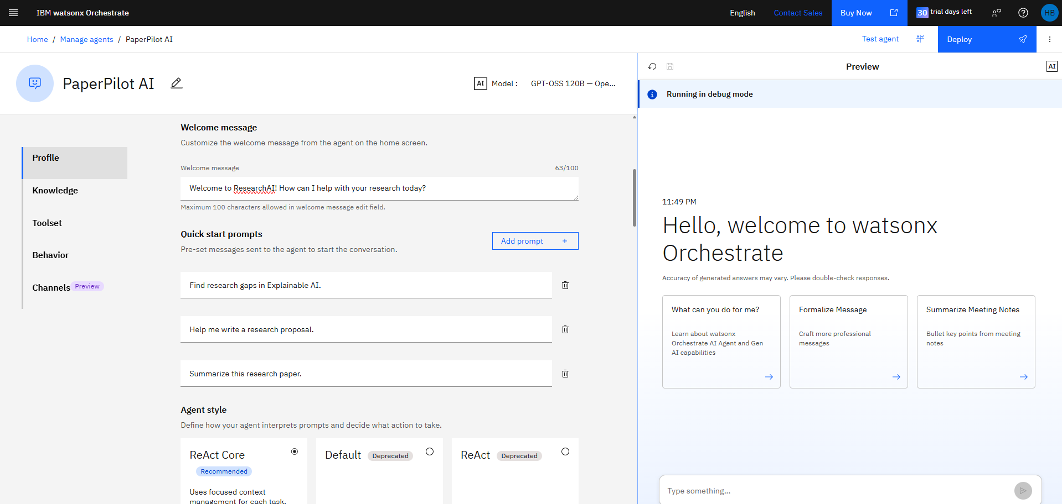
Langflow workflow:

Slide 8
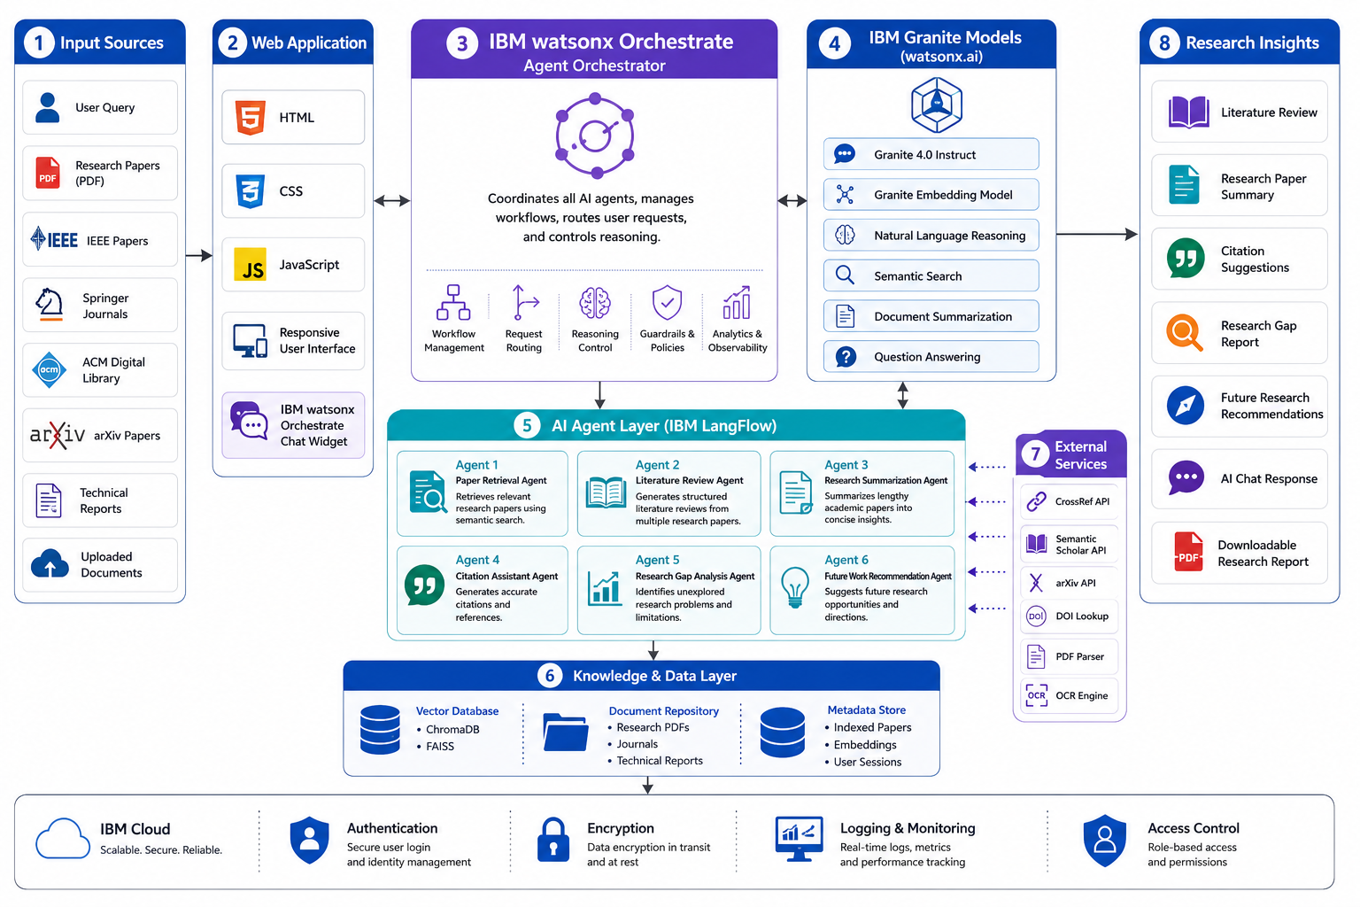
Architecture Blueprint:

Slide 9
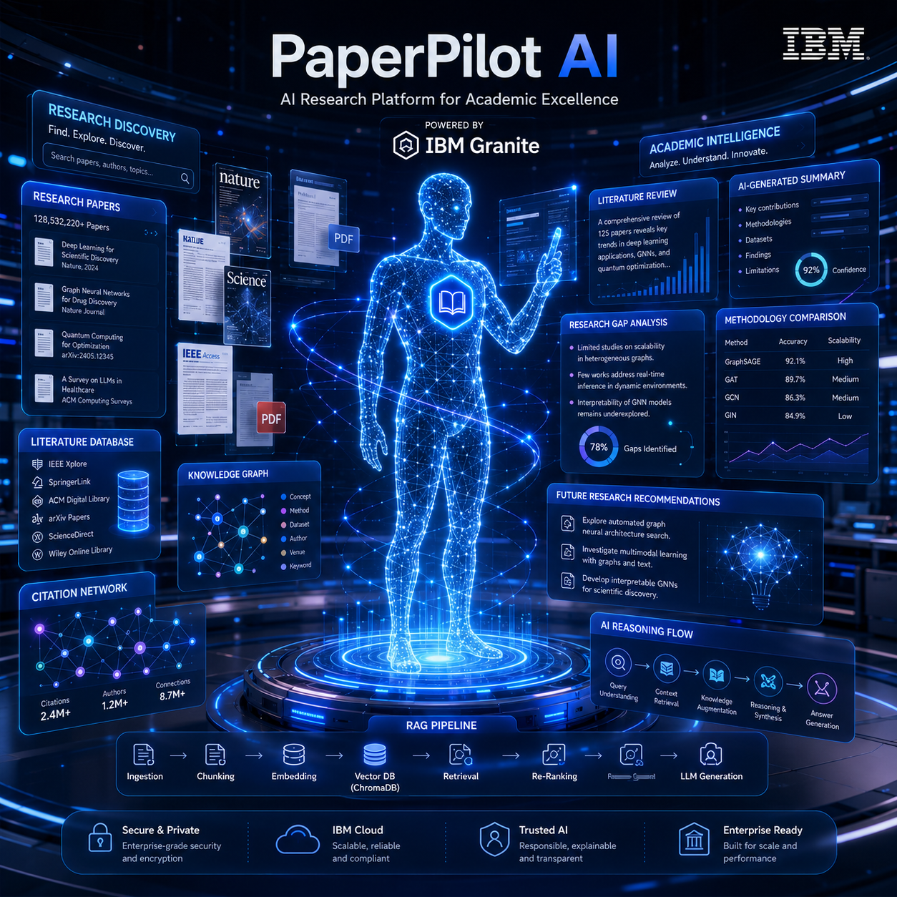
Role of Agentic AI in the solution:
Autonomous Research Assistant – Performs intelligent research tasks beyond simple question answering.
Paper Discovery – Retrieves relevant academic papers using Retrieval-Augmented Generation (RAG).
Literature Review – Combines information from multiple research papers into structured reviews.
Research Summarization – Extracts key findings, methodologies, and conclusions from technical documents.
Research Gap Analysis – Identifies unexplored areas and limitations for future investigation.
Future Recommendations – Suggests promising research directions based on analyzed literature.
Intelligent Orchestration – IBM watsonx Orchestrate coordinates AI workflows powered by IBM Granite Models to deliver accurate, explainable, and context-aware academic insights.

Slide 10
Novelty and Uniqueness:
Novelty
• Agentic AI-powered research assistant
• Multi-agent collaboration
• Retrieval-Augmented Generation (RAG)
• Automatic literature review generation
• Intelligent research gap detection
• Citation recommendation
• Future research suggestion
• Explainable AI responses
Uniqueness
Unlike traditional research search engines, the Research Agent not only retrieves papers but also analyzes, summarizes, compares, and synthesizes research information into structured academic insights. The system acts as an intelligent research companion capable of reducing literature review time while improving research quality.

Slide 11
Git Hub Link:
Repository Name-paperpilot
Repository includes-
• Source Code (index.html)
• app.json
• README.md
• LICENSE
• Project Presentation (PPT)
• IBM Problem Statement (PDF)
Git Hub Repo-
https://github.com/harshad-bgt/paperpilot
·
·
·

Slide 12
Future Scope:
• Integration with IEEE Xplore, ACM, Springer, and PubMed APIs
• Automatic survey paper generation
• Citation graph visualization
• AI-powered proposal writing assistant
• Research collaboration recommendations
• Patent search integration
• Voice-enabled research assistant
• Multi-language academic support
• Plagiarism detection assistance
·
·
·

Slide 13
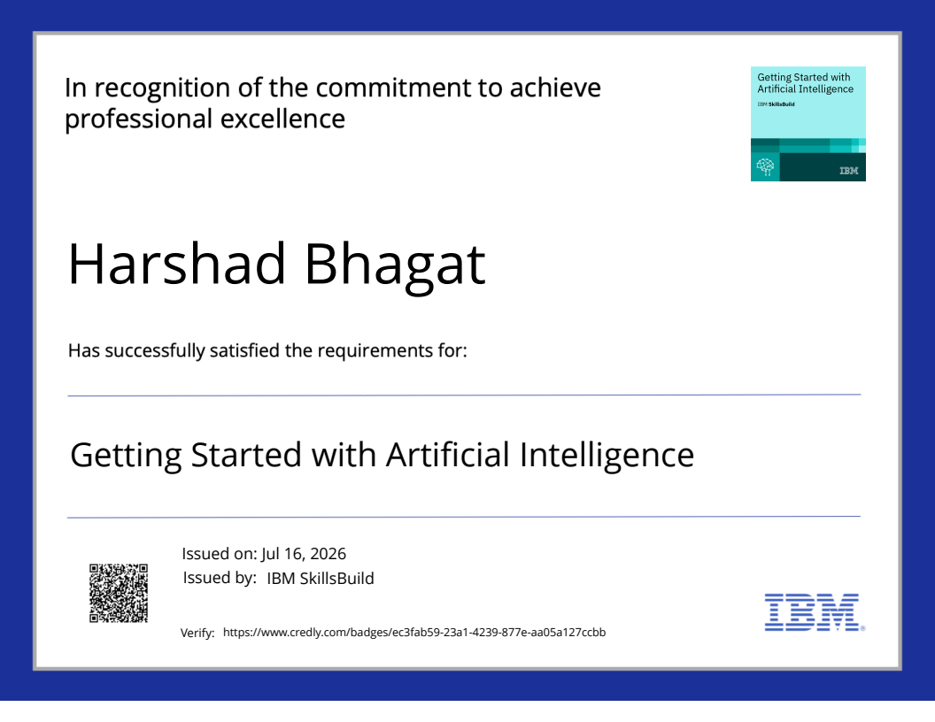
Certificates Earned:

Slide 14
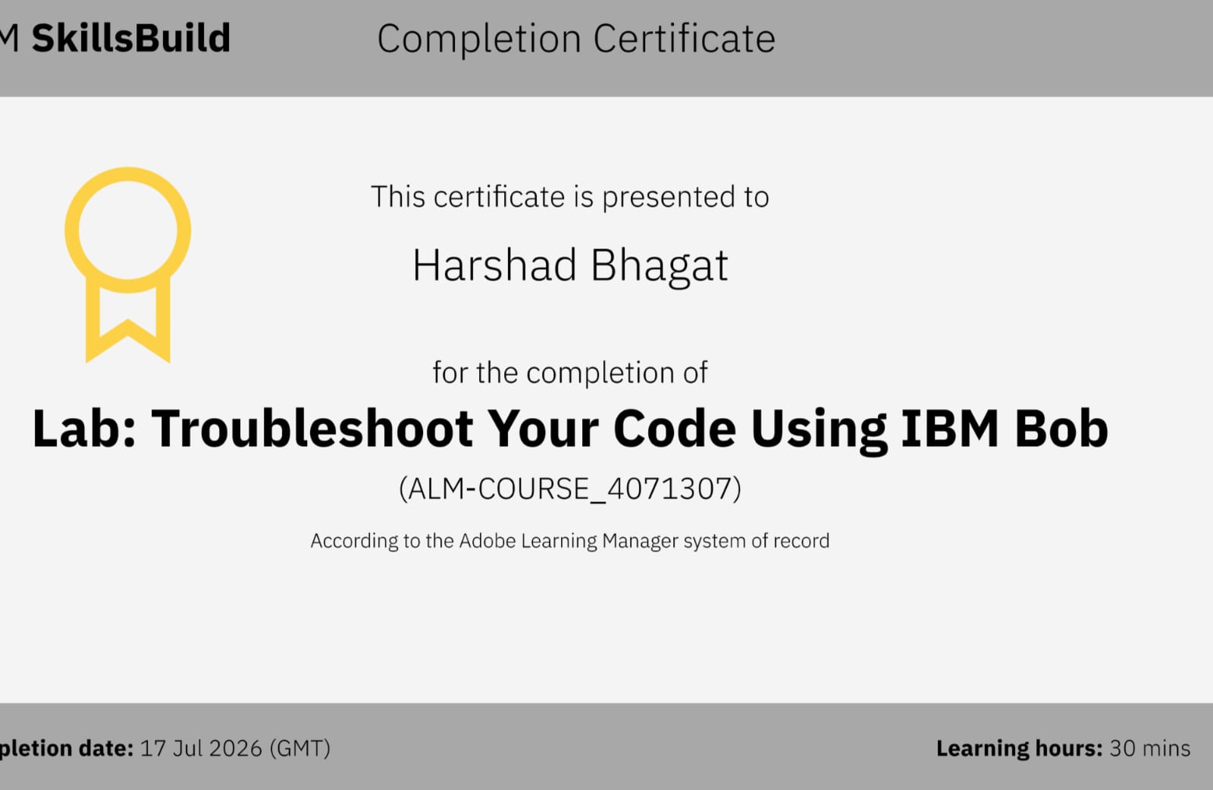
Certificates Earned:​

Slide 15


